Slide 1
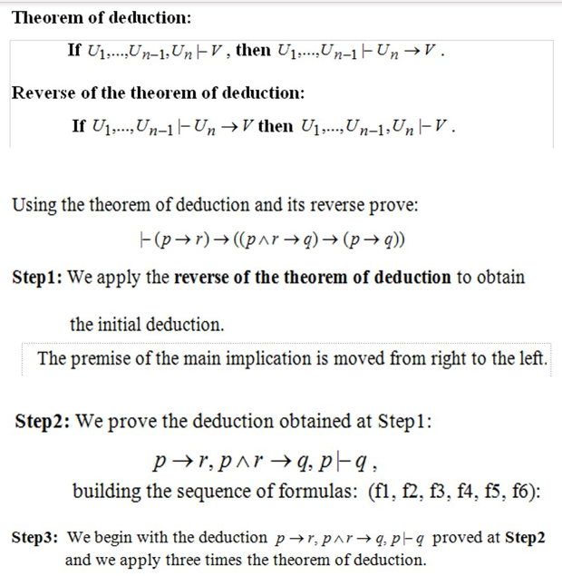

Slide 2
10. Prove the following theorems using the theorem of deduction and its reverse.
a) ⊢ p ∨ (q → r) → ((p ∨ q) → (p ∨ r))
U ∨ V = ¬ U → V (we’ll apply this logical equivalence to our exercise - to each one)
Then: ⊢ ¬ p → (q → r) → ((¬ p → q) → (¬ p → r))
Also, we’ll apply to ¬ p → (q → r) the reunion of the premises law:
U → (U→ Z) → (V ∧ U→Z)
¬ p → (q → r) = (q ∧ ¬ p → r) (&)
Rewriting a) from (&) relation:

Slide 3
⊢ (q ∧ ¬ p → r) → ((¬ p → q) → (¬ p → r))
Step 1 (Reverse Theory of Deduction)
(q ∧ ¬ p → r) ⊢ (¬ p → q) → (¬ p → r)
(q ∧ ¬ p → r), (¬ p → q) ⊢ (¬ p → r)
(q ∧ ¬ p → r), (¬ p → q), ¬ p ⊢ r (*)
Step 2 (we’ll prove (q ∧ ¬ p → r), (¬ p → q), ¬ p ⊢ r )
F1: q ∧ ¬ p → r
F2: (¬ p → q)
F3: ¬ p
--------------------------
F2, F3 ⊢ q: f4 (mp)
F4, F3 ⊢ q ∧ ¬ p: f5 (conj in concl)
F5, F1 ⊢ r: f6 (mp)

Slide 4
Step 3 (we’ll apply Theorem of deduction):
(q ∧ ¬ p → r), (¬ p → q), ¬ p ⊢ r
(q ∧ ¬ p → r), (¬ p → q) ⊢ ¬ p → r
(q ∧ ¬ p → r) ⊢ ((¬ p → q) → (¬ p → r))
⊢ (q ∧ ¬ p → r) → ((¬ p → q) → (¬ p → r))
We’ll use: (V ∧ U→Z) → U → (U→ Z)
(q ∧ ¬ p → r) → ¬ p → (q → r)
We’ll use: (¬ U) → V = U ∨ V
¬ p → (q → r) → p ∨ (q→ r) (#)
(¬ p → q) = p ∨ q (##)
(¬ p → r) = p ∨ r (###)
Last time we had:
⊢ (q ∧ ¬ p → r) → ((¬ p → q) → (¬ p → r))
From (#), (##), (###) we’ll obtain:
⊢ T1 = p ∨ (q→ r) → (p ∨ q) → (p ∨ r) (as the initial one)

Slide 5
In conclusion, there are 3! = 6 possibilities (to move the premises to the right side in deduction method, so we could obtain easily other 5 theorems, besides this T1 that was proved.
⊢ T1 = (q ∧ ¬ p → r) → ((¬ p → q) → (¬ p → r))
⊢ T2 = (q ∧ ¬ p → r) → (¬ p → ((¬ p → q) → r))
⊢ T3 = ((¬ p → q) → (q ∧ ¬ p → r) → (¬ p → r))
⊢ T4 = ((¬ p → q) → (¬ p ((q ∧ ¬ p → r) → r))
⊢ T5 = (¬ p → r) → (q ∧ ¬ p → r) → (¬ p → r))
⊢ T6 = (¬ p → r) → (¬ p→ ((q ∧ ¬ p → r) → r))

